Slide 1


Project Director, Beth Walsh, M.Ed.
Notes:
Michele, quick welcome here….

Slide 2
Vermont is the most rural state in the US, with 62% of the population living in rural areas and 76% of grade 9 to 12 students attending rural high schools. Rural students are currently less likely than their urban counterparts to enroll in and graduate from four-year education programs. In Vermont, only 59% of rural students enroll in higher education, compared to 67% of urban and suburban students. This jeopardizes both the prospects for the students to enter high-wage jobs and also for the Vermont workforce, which has a strong need for highly skilled workers in a variety of fields. Vermont Business Magazine, 1/24/24
Notes:
Michele, quick welcome here….

Slide 3
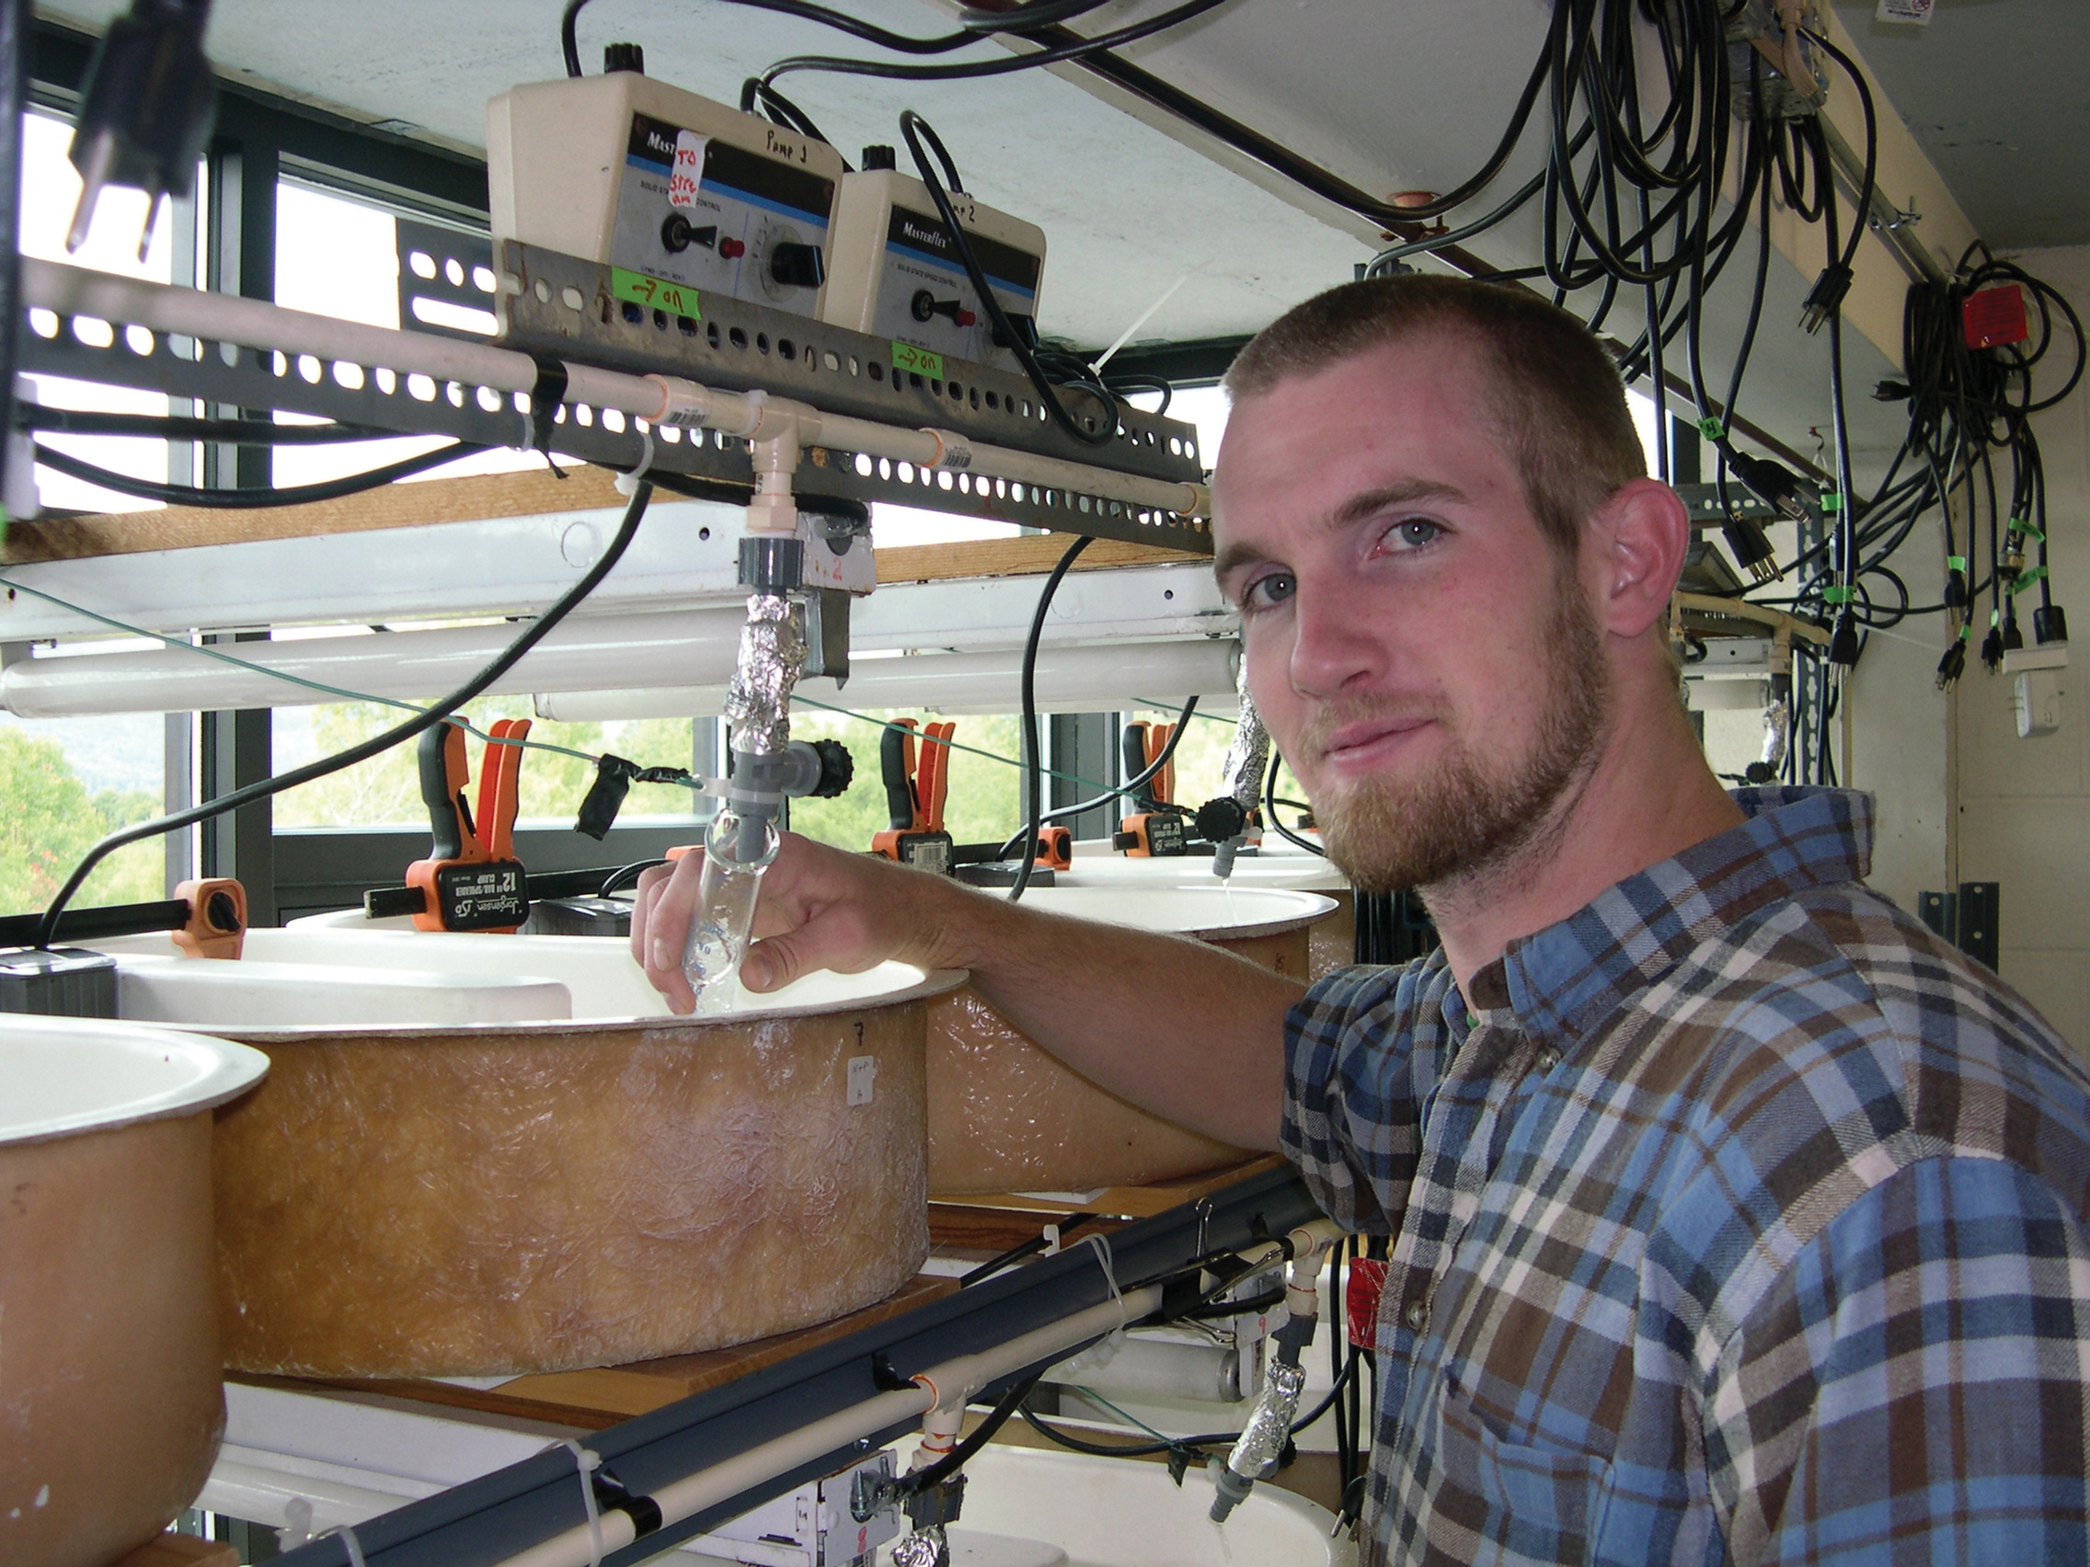
The ROAD (Rural Opportunities and Development) to Success project is a federally funded project (#P116W230038) to help address some of the barriers that rural Vermont students often experience when pursuing higher education. This project is also dedicated to working with educators, community leaders and employers to identify ways to encourage our rural Vermont students to reach for the high-skill careers that Vermont needs the most.
Notes:
Michele, quick welcome here….

Slide 4
Introduction
The People
Jen Jones, Yasmine Ziesler, Chris Boettcher, original grant committee
Beth Walsh, Director, Johnson campus
Bill Lucci, Assistant Director in Career Pathways
Sawyer Judkins, ROADS Student Success Advisor
4 Year Grant ~ $1,900,000 over four years
Awarded 1/2024
Rural Postsecondary and Economic Development (RPED) Program
Scheduled to end 12/2027
Goals
Increase the number and proportion of rural students, particularly low-income and underserved
who transfer and/or enroll at VTSU in postsecondary education programs,
By developing and implementing student success programs that integrate multiple comprehensive and evidence-based services or initiatives, such as academic advising, structured/guided pathways, career development, student financial aid, and access to technological devices.
Increase the number of high-quality and accessible learning opportunities at VTSU, including learning opportunities that are accelerated or hybrid online, credit-bearing; and flexible for working students.

Slide 5
Eligible high schools , CCV and VTSU campuses
Eligible Rural High Schools
Arlington Memorial
Bellows Falls UHSD #27
Bellows Free Academy (Fairfax)
Bellows Free Academy (St. Albans)
Black River
Blue Mountain USD #21
Brattleboro Union
Burr and Burton Academy
Cabot School
Canaan Memorial
Central Vermont Career Center
Champlain Valley Union
Colchester
Cold Hollow Career Center
Craftsbury Schools
Danville School
East Burke
Enosburg Falls Junior/Senior
Excel
Fair Haven Union
Grace Christian School
Green Mountain Technology and Career Center
Green Mountain Union
Green Mountain Valley School
Hartford
Hartford Area Career and Technology Center
Harwood Union
Hazen UHSD #26
Lake Region UHSD #24
Lamoille Union
Leland & Gray Union
Long Trail School
Lyndon Institute
Middlebury Union
Mill River Union
Mid Vermont Christian School
Mississquoi Valley Union
Montpelier
Mount Anthony UHSD #14
Mt. Abraham UHS #61
Mount Mansfield Union HS
Mount St. Joseph
North Branch School
North Country Career Center
North Country Senior UHSD #22
Northfield
Northwest Career and Technical Center
Otter Valley Union
Oxbow Union
Patricia A. Hannaford Career Center
Peoples Academy
Poultney
Proctor Junior/Senior
Randolph Technical Career Center
Randolph Union
Richford Junior/Senior
River Valley Technical Center
Riverbend Career and Technical Center
Rutland Senior
Southwest Tech
Spaulding Union
Springfield
St. Johnsbury Academy
Stafford Technical Center
Stowe
Stratton Mountain School
The Gailer School
The Greenwood School
The Putney School
The Sharon Academy
Thetford Academy
Twin Valley
Twinfield USD #33
U-32 Middle/High
Vergennes Union
Vermont Academy
West Rutland
White River Valley
Williamstown
Windham Regional Career Center
Windsor
Woodstock
Rural Vermont home school or private school locations
Eligible CCV Campuses
Bennington
Brattleboro
Middlebury
Montpelier
Morrisville
Newport
Rutland
Springfield
St. Albans
St. Johnsbury
Upper Valley
Eligible VTSU Campuses
Castleton
Johnson
Lyndon
Randolph
Other satellite campuses in rural communities around the state (outside of Chittenden County)
Consideration given to Grand Isle high school students

Slide 6
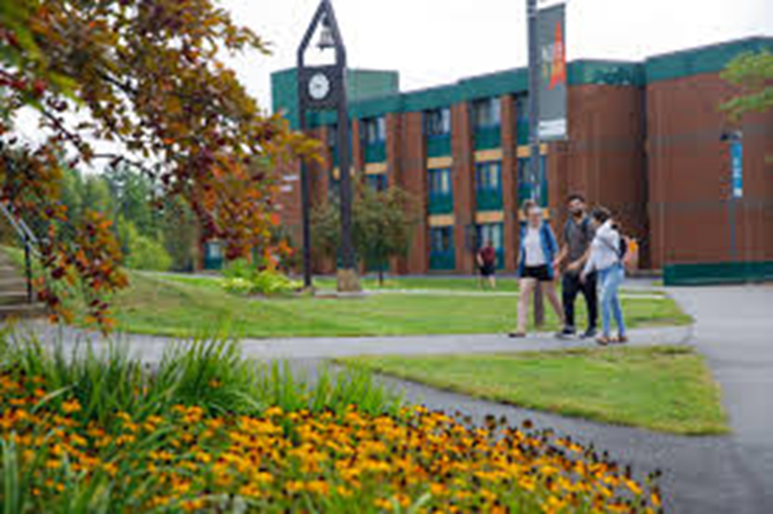
Student Support
Laptop or iPad loaners
Help with Broadband connection
Unpaid and underpaid internships
Research
Student Teaching
Job shadowing
Conferences
Professional Development

Slide 7

Increase the number of hybrid and/or 100% remote job-shadowing, research, and internship opportunities
Collaborate with the Vermont Department of Labor, VTSU Workforce, Community and Economic Development and industry leaders to develop hybrid and/or 100% remote job-shadowing and internship opportunities

Slide 8
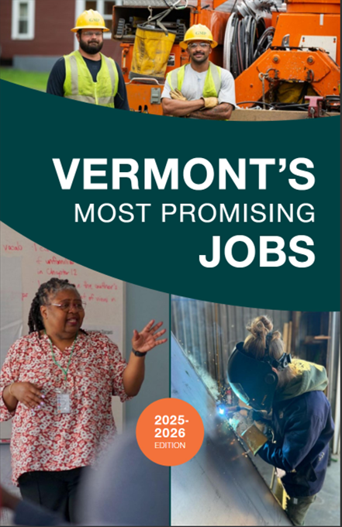
Career Pathways
Support faculty work to create structured “career pathways” that guide students through higher education to high-skill, high-wage, and in-demand occupations.
Gather potential student input through surveys, interviews, and/or focus groups.
Promote new structured pathways to potential students at rural high schools and CCV.
Prioritize alignment of CCV certificates that are also on McClure high-wage, high-demand list as part of Direct Admissions pathways to 4-year VTSU degrees. https://vermontstate.edu/admission/transfer-and-returning-students/ccv-students/
Develop the certificate or credential program content through collaboration with faculty and workforce development to ensure that it meets the needs of Vermont employers.
https://mcclurevt.org/most-promising-jobs/

Slide 9



Collaboration
Collaborate with:
Rural Vermont High Schools
Community College of Vermont
Vermont Agency of Education
TRiO programs
VSAC, GEAR Up and Upward Bound Programs
Industry Leaders
McClure Foundation
VTSU Center for Workforce and Professional Education
VTSU Career Development
VTSU Student Success Advisors
VTSU Workforce, Community and Economic Development
VTSU Center for Teaching and Learning
VTSU Faculty, Staff and Students
McNair Scholars

Slide 10
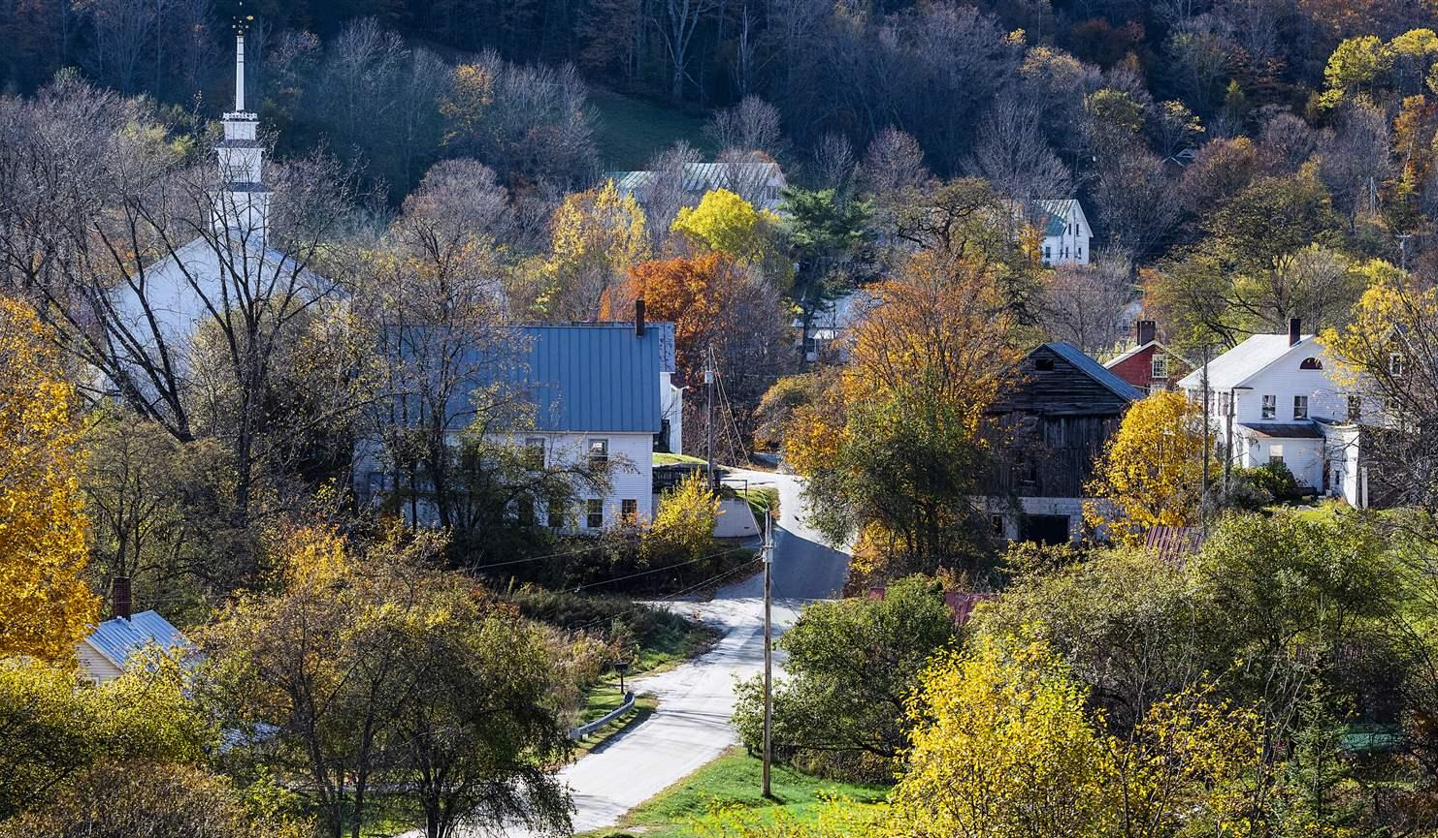
Rural Councils and Community Connections
Current language:
Establish and convene three regional rural councils with other industry partners, community organization and employers.
Collaborate with partners and identify gaps in postsecondary education and economic development opportunities.
Partnerships will facilitate internships, work-study opportunities, research and innovation collaborations, and community engagement initiatives.
Create a network that extends beyond the grant period, providing ongoing benefits and opportunities for students, faculty, and rural communities in Vermont.

Slide 11
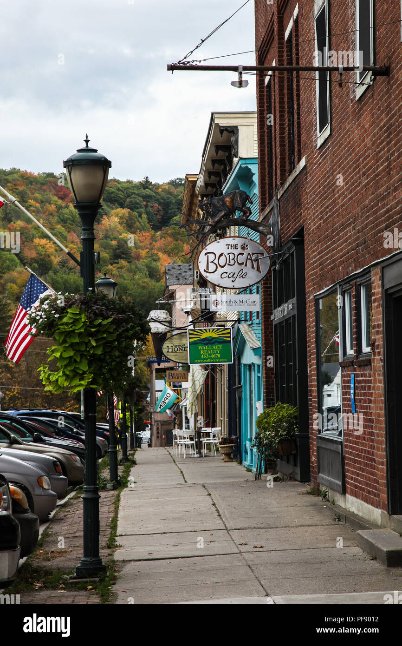
Rural Councils and Community Connections
Proposed language:
Establish connections with regional rural councils, industry partners, community organization and employers.
Collaborate with partners and identify gaps in postsecondary education and economic development opportunities.
Help to facilitate internships, work-study opportunities, research and innovation collaborations, and community engagement initiatives.
Support a network that extends beyond the grant period, providing ongoing benefits and opportunities for students, faculty, and rural communities in Vermont.
Why? No additional meetings. Bringing education into economic discussions. Ability to support more Vermont communities.

Slide 12
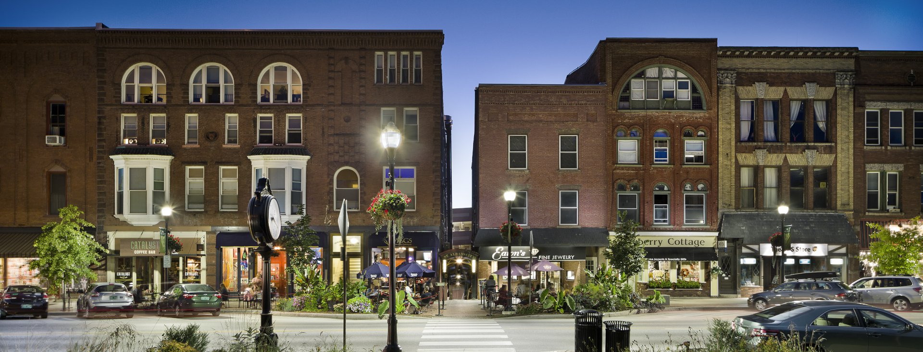
How can we work together?

