Slide 1
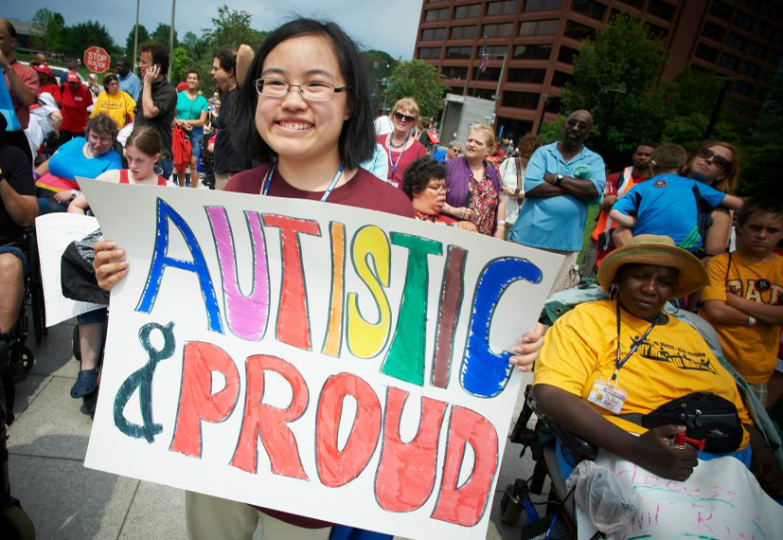
Pride & Self-Advocacy
A keynote by Eli Clare (May 2, 2023) eliclare.com

Slide 2
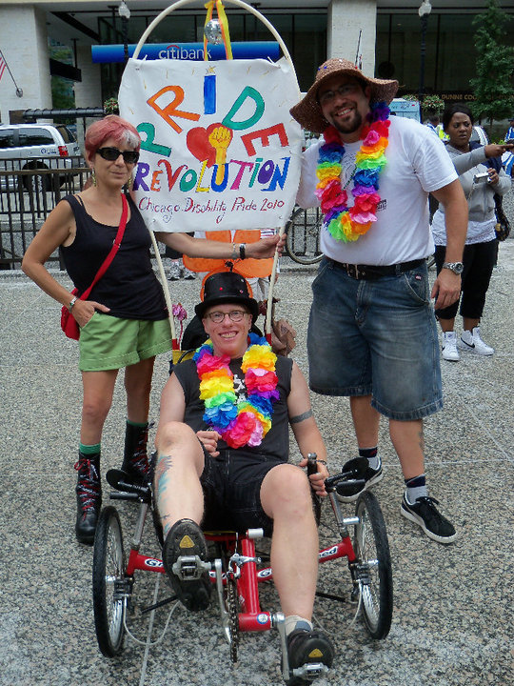
A Bit About Me
I am:
a proud disabled queer person
activist
writer
I love being part of disability community.

Slide 3
We do self-advocacy work because:
as disabled people, we face
disrespect
invisibility and hyper-visibility
lack of access
isolation
bullying and violence
injustice

Slide 4
Saying NO to the stereotypes
The ableist stereotypes (otherwise known as lies) try to tell us:
that we’re not valuable
that we’re burdensome
that we’re better off dead
that we’re child-like
that we’re tragic and pitiful
that we’re inspirational
that we’re dangerous
that we don’t have sexualities
Lies, lies, lies.

Slide 5
Becoming rebellious & non-compliant
I want us to shred the lies and stereotypes.
This can be hard work.
We sometimes deep down believe the lies about ourselves.
We need resources:
community
knowing we’re not alone
self-acceptance
disability pride

Slide 6
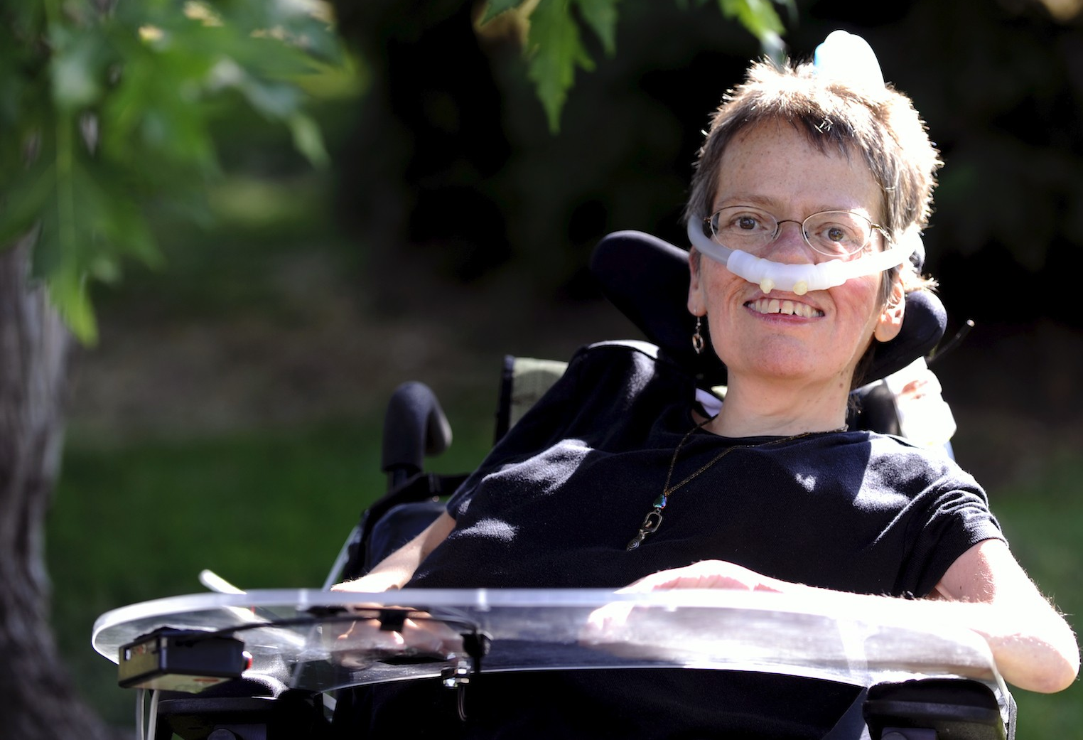
Disability Pride
YOU GET PROUD BY PRACTICING
By Laura Hershey
If you are not proud
For who you are, for what you say, for how you look;
If every time you stop
To think of yourself, you do not see yourself glowing With golden light; do not, therefore, give up on yourself. You can get proud.

Slide 7
YOU GET PROUD BY PRACTICING (part 2)
You do not need
A better body, a purer spirit, or a Ph.D.
To be proud.
You do not need
A lot of money, a handsome boyfriend, or a nice car. You do not need
To be able to walk, or see, or hear,
Or use big, complicated words,
Or do any of those things that you just can’t do
To be proud. A caseworker
Cannot make you proud,
Or a doctor.
You only need more practice.
You get proud by practicing.

Slide 8
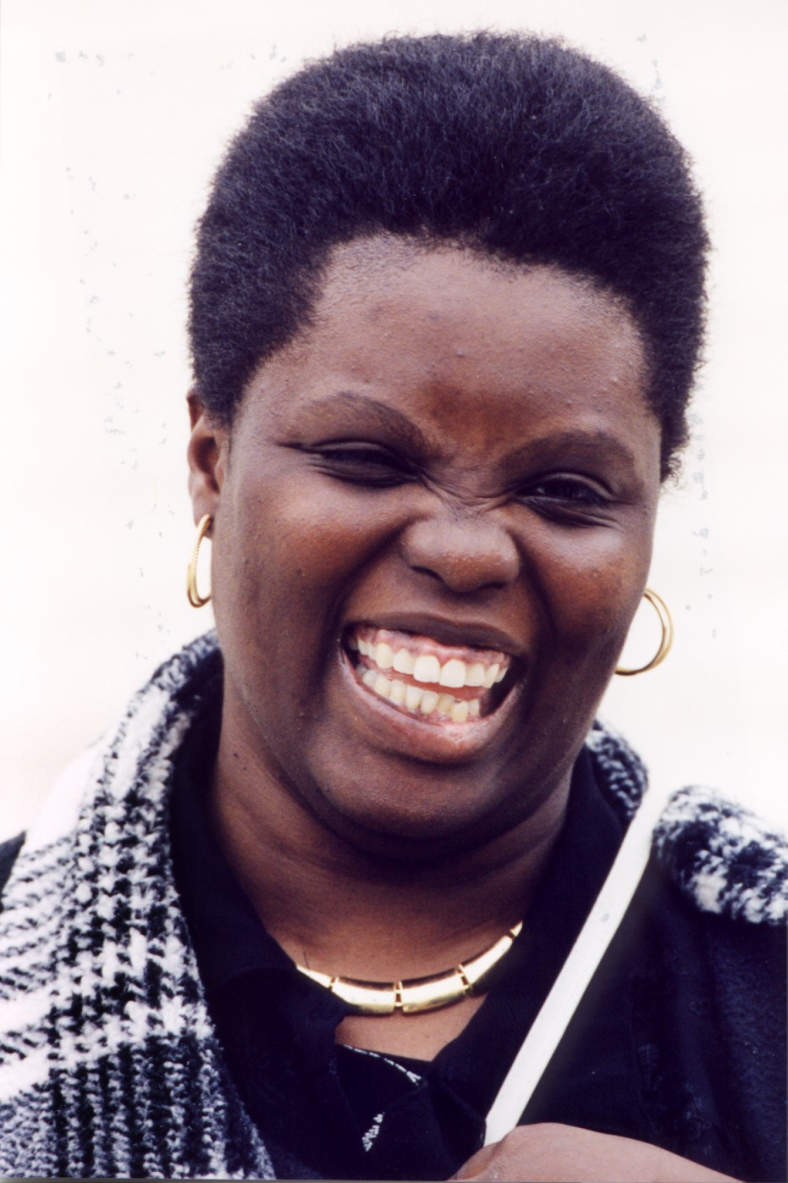
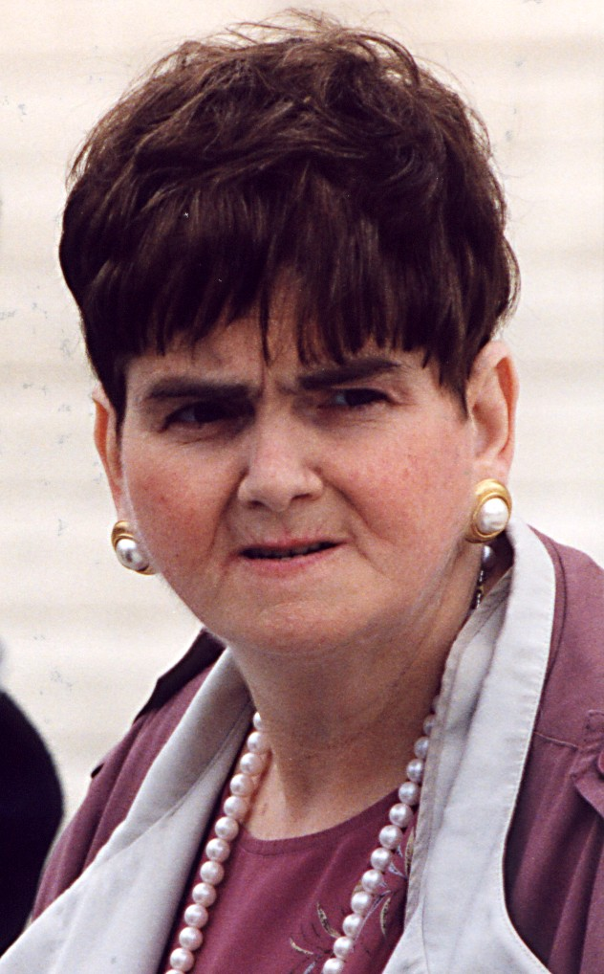
Practicing Pride,
Practicing Self-Advocacy
Knowing we’re not alone.
Knowing disability histories.
The people who have gone before us.
Self-advocates Lois Curtis and Elaine Wilson

Slide 9
YOU GET PROUD BY PRACTICING (part 3)
There are many many ways to get proud.
You can try riding a horse, or skiing on one leg,
Or playing guitar,
And do well or not so well,
And be glad you tried
Either way.
You can show
Something you’ve made
To someone you respect
And be happy with it no matter
What they say.
You can say
What you think, though you know
Other people do not think the same way, and you can
keep saying it, even if they tell you
You are crazy.

Slide 10
Lois Curtis
From the age of 11, she lived in state-run institutions for a total of 20 years.
She was very unhappy.
In the early 1990s, she started calling Legal Aid in Atlanta.
She kept saying, “Get me out of here.”
She was persistent and fierce.

Slide 11
YOU GET PROUD BY PRACTICING (part 4)
You can add your voice
All night to the voices
Of a hundred and fifty others
In a circle
Around a jailhouse
Where your brothers and sisters are being held
For blocking buses with no lifts,
Or you can be one of the ones
Inside the jailhouse,
Knowing of the circle outside.
You can speak your love
To a friend
Without fear.

Slide 12
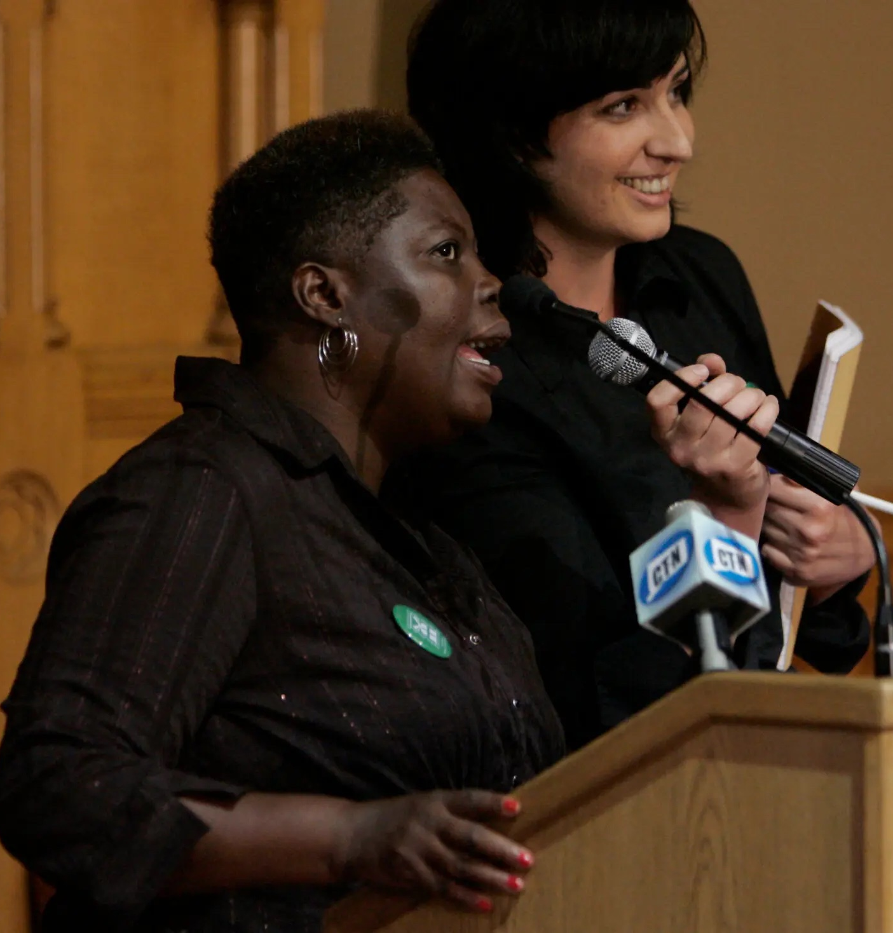
more on Lois Curtis
In 1995 she, along with lawyer Sue Jamieson, sued the state of Georgia.
Case went to the Supreme Court.
In 1999 they won.
Paved the way for Ms. Curtis moving out of institutional living.

Slide 13
YOU GET PROUD BY PRACTICING (part 5)
You can find someone who will listen to you
Without judging you or doubting you or being
Afraid of you
And let you hear yourself perhaps
For the very first time.
These are all ways
Of getting proud.
None of them
Are easy, but all of them
Are possible. You can do all of these things,
Or just one of them again and again.
You get proud
By practicing.

Slide 14
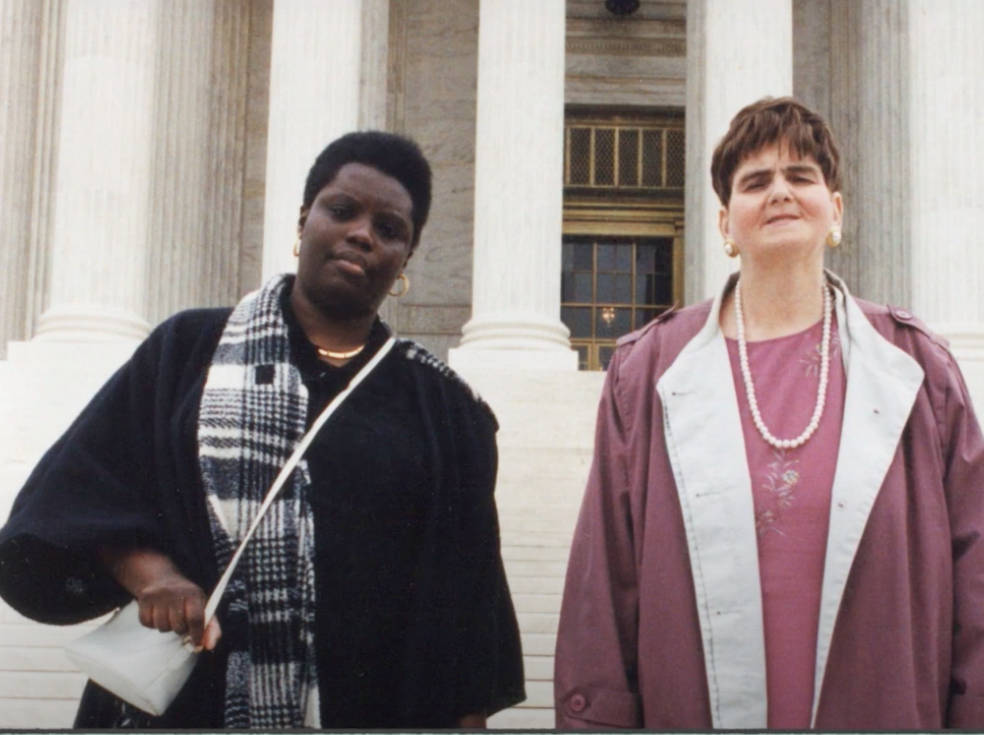
Together, Not Alone

Slide 15
YOU GET PROUD BY PRACTICING (part 6)
Power makes you proud, and power
Comes in many fine forms
Supple and rich as butterfly wings.
It is music
when you practice opening your mouth
And liking what you hear
Because it is the sound of your own
True voice.
It is sunlight
When you practice seeing
Strength and beauty in everyone,
Including yourself.

Slide 16
Ms. Curtis’ Freedom
Such powerful self-advocacy.
In a 2020 video, Ms. Curtis said, “I am glad to be free.”

Slide 17
YOU GET PROUD BY PRACTICING (part 7)
It is dance
when you practice knowing
That what you do
And the way you do it
Is the right way for you
And cannot be called wrong.
All these hold
More power than weapons or money
Or lies.
All these practices bring power, and power
Makes you proud.
You get proud
By practicing.

Slide 18
Self-Advocacy Rippling Out

Slide 19
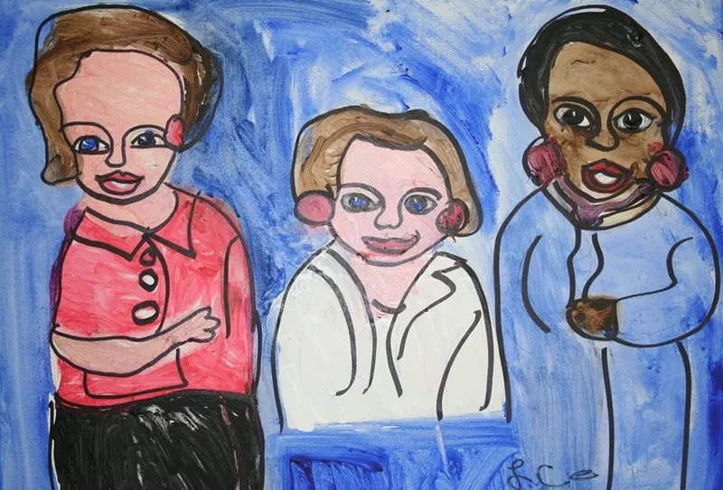
Our Collective Voices
Very big impact of the work of Elaine Wilson, Susan Jamieson, and Lois Curtis.
Together we can defend and strengthen ourselves and each other.

Slide 20
YOU GET PROUD BY PRACTICING (part 8)
Remember, you weren’t the one
Who made you ashamed,
But you are the one
Who can make you proud.
Just practice,
Practice until you get proud, and once you are proud,
Keep practicing so you won’t forget.
You get proud
By practicing.
Poem by Laura Hershey:
http://www.laurahershey.com/?p=340:
More by and about Laura Hershey:
Laura Hershey: On the Life and Work of an American Master

Slide 21
Thank you all!
eliclare.com
eli@eliclare.com

