Slide 2
The Importance of Non-Knowing Growing and the Rejection of Hustle Culture
Vermont Interagency Core Team Event
October 11, 2022

Slide 3
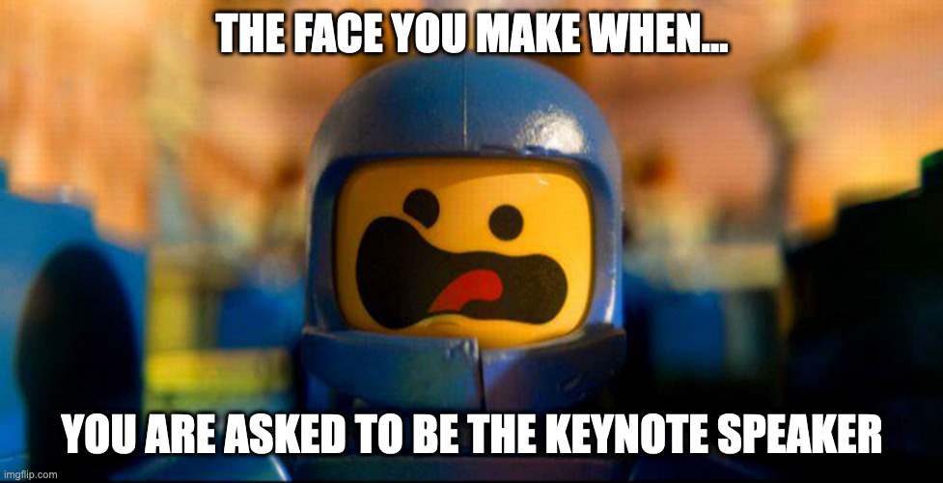

Slide 4
Who Am I?
Non-Binary; Queer
Pronouns: They/Them
Geriatric Millennial
Lover of Muppets, Hippos, Legos, and Converse
Asking for and Giving Grace
I have privilege
Harm and Accountability
Humility, Relationality, and Equity are the heart of my core values

Slide 5
Diversity, Equity, Inclusion, and Accessibility (DEIA) Defined
The Center for Apprenticeships and Work-Based Learning operated by Jobs for the Future (JFF) who’s mission is to transform the American workforce and education systems to ensure economic advancement for all defines DEIA as:
Diversity: The representation and proactive valuing of varied identities, differences, and perspectives, honoring our lived experiences collectively and individually.
Equity: Intentional distribution of access and resources to remove the predictability of success or failure that correlates with entrenched outcome disparities in our society.
Inclusion: The creation of a culture of belonging that prioritizes the contribution and participation of all people in executing an organization’s mission, values, and goals.
Accessibility: The facilitation of full and independent access for all people to employment, facilities, services, and information through intentional design, development of accommodations, and respect for the wide range of human ability.
Notes:
Honoring Lived Experiences

Slide 6
Group Discussion: American Culture - 1
How might one be inclined to finish these sentences…
You must work hard to get good grades in school so you can….
You must work hard and go to a good college so you can….
You must work hard to get a good job and earn good money so you can…
What do all these statements share?

Slide 7
Group Discussion: American Culture - 2
When you think about the culture of America, what would you say are some of America’s cultural ideals?
Notes:
No wrong Answers…
Independence, Individualism, Freedom, Diversity, Patriotism, Capitalism/Private Enterprise, Extroversion, Informality, Equal Opportunity
https://www.bu.edu/isso/files/pdf/AmericanValues.pdf
Individualism, Equality, Informality, Future, Change, Progress, Achievement, Action, Work, Materialism, Directness, Assertiveness, Time
https://www.up.edu/iss/advising-services/american-values.html

Slide 8
What does Success Look Like?

Slide 9
Group Discussion: Learning & Development
What influences how people learn and develop? Biology? Social Experiences? Culture? All three?
How do we learn and develop?
School?
Books?
People?
Experience?
What indicates that we have learned and developed?
How do we traditionally measure learning and development?

Slide 10
Knowledge Paradigm
“Nearly every one of our institutions– schools, the health and mental health system, the legal system, politics, the media, science, the courts– is organized around knowing. Knowing what’s true, who’s right, what’s going on, what’s good for you, what you should do. Having the facts, providing the evidence, explaining how things work.” (Holzman, 2018, p.4)

Slide 11
Any Closer to Diversity, Equity, Inclusion & Access?
Yet…despite all we “know” are we any closer to solving or eliminating disparities across different groups in our society?
What counts as knowledge?
Who determines what counts?

Slide 12
Strategies to Move Towards Diversity, Equity, Inclusion and Access…
Understand the Human Brain
Understand, the Socio-Ecological Perspective, Social Identity & Influence of Oppression
Acknowledge & Address Systemic Oppression, Power Differentials in Helping Relationships and Unconscious Bias
Slow Down
Engage in Critical Self-Reflection
Aim to Co-Construct
Asking Instead of Telling - Humble Inquiry
Notes:
By Slowing Down and Asking…
What counts as knowledge?
Who determines what counts as knowledge?

Slide 13
The Human Brain & Mental Models
Information Processing
Consciously aware of only a very small portion of the millions of bits of data we process every second, so our brain creates cognitive shortcuts to help is process.
Subconscious Mind
Categorizes
Creates Associations
Fills in the Gaps
Mental Models
The frames that help us understand and navigate the world (e.g. the knowledge paradigm). Largely based on our cultural and social experiences and interactions.

Slide 14
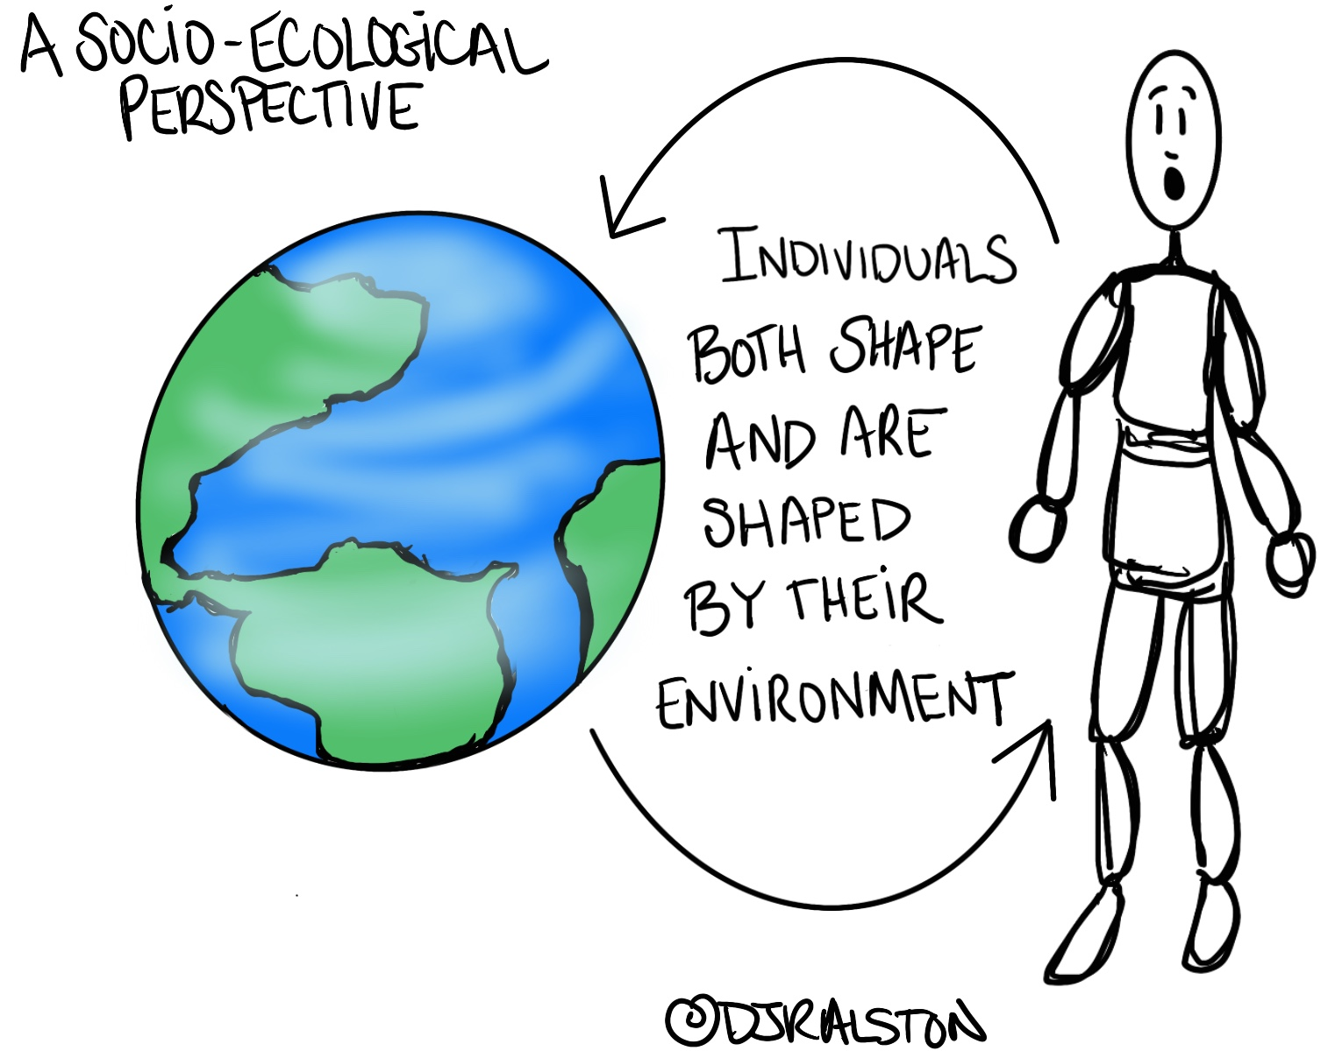
Socio-Ecological Perspective
A socioecological perspective accounts for the idea that individuals both shape and are shaped by their environment and provides a framework to understand to what degree oppressive environmental influences impact the mental health and well-being of individuals.
Exploring social environments is crucial to understanding the impact of intersectionality and oppression on an individual’s well-being and mental health (Ratts, Et. Al., 2015).

Slide 15
The Evolution of Social Identity Theory
The social construction of identity is far more nuanced and dynamic than originally understood and conceptualized (Ratts, Et. Al. 2015).
Early research and literature understood identity as single variables as opposed to the linked parts which consequently ignores the interconnected system of identities that comprise human identity (Ratts, Et. Al. 2015).
Mainstream discourse on intersectionality asserts that human identity is comprised of race, ethnicity, gender identity, sexual orientation, economic status, religion and disability and that all of these are socially constructed and intersect fluidly a different points in time contributing to one’s dynamic positionality as in society (Ratts, Et. Al. 2015).
What’s more this shapes people’s understanding and experience of privilege and oppression with their environment influencing which identity is most salient at a given moment in time (Ratts, Et. Al. 2015).
Recognizing the existence of multiple identities is paramount to understanding the complexities for persons from systematically and historically marginalized and excluded groups.

Slide 16
The Influence of Oppression
According to Adams, Bell, & Griffin (2007) oppression exists in several forms (i.e., racism, sexism, heterosexism, classism, ageism, ableism, etc.) and is experienced at both individual and systemic levels.
Individual – Microaggressions (i.e., being misgendered)
Systems – Policies, Rules, Laws & Institutions (i.e., sub-minimum wage)
Regardless of whether intentional or unintentional, oppression has destructive ramifications on the mental health and well-being of systematically and historically marginalized and excluded individuals, populations, and communities.
Minority Stress
Transgender Suicide Rate
Poverty
Oppression has a biopsychosocial impact

Slide 17
Unconscious Bias
Unconscious Bias is the result of our limited cognitive capacity
It is our unintentional preferences formed by our socialization and experiences, including exposure to (social) media
There are an overwhelming number of studies that have shown the significant impact unconscious bias can have on human cognitive processes
Unconscious biases are unavoidable we all have them
What do we do about Unconscious Bias?

Slide 18
What Can We Do?: Acknowledge and Address the Inherent Power Differential
Within the helping-relationship (such as that of a Transition Professional and a Student or Youth) there is always an inherent power differential because one party needs assistance which leaves them with less power than the person helping.
In Transition helping-relationships that inherent power differential is typically compounded by cultural and societal norms associated with age difference.
What other power differential often exists (hint: Abled vs. Disabled)

Slide 19
What Can We Do?: Acknowledge and Address Bias
Slow Down
Bias is more likely to creep in when we are forced to make quick decisions.
Consciously engage in critical self-reflection – Ask Yourself:
What and who are controlling the narrative in this situation?
What do you know about the student/youth you are working with? How do you know that? Why is that knowledge valid? Are there other sources of knowledge that should be considered?
How is success being defined? Who is defining it?
Why is one course of action recommended and not another? Who benefits most from the course of action recommended?

Slide 20
What Can We Do?: Aim to Co-Construct
How can we co-construct?
Value Relationship(s) over Task Accomplishment
Willingness to engage in non-knowing growing
Use of Humble Inquiry

Slide 21
Aim to Co-Construct: Value Relationship over Task Accomplishment
Schein, E. (2013). Humble Inquiry: The gentle art of asking instead of telling. Barret-Koehler Publishers, Inc.

Slide 22
Aim to Co-Construct: Non-Knowing Growing
Don’t just think outside the box, be willing to give the box up altogether (Holzman, 2018)
A central part of transitioning from adolescence to adulthood is “adapting to culture and society in both ‘big’ the shared human ones and the specific ‘time and place’ ones (Holzman, 2018, p.32)
Humans are always adapting to culture and society that we are creating but then we also create with that adaptation and then adapt again – a constant state of transforming the circumstances we’re in – a state of always becoming (Holman, 2018).
Therefore, we should lean into not knowing - abandon what we think they know and what we think they don’t know – relate to them as developing, as they are becoming (Holzman, 2018)

Slide 23
Aim to Co-Construct: What Do You See? Humble Inquiry
Here and Now Humility
Ability and willingness to be vulnerable to concede you are dependent on the knowledge the other person holds.
Asking instead of Telling – Asking builds relationships
“Humble Inquiry is the fine art of drawing someone out, of asking questions to which you do not already know the answer, of building a relationship based on curiosity and interest in the other person” (Schein, p.2)
Photo (Koch, 2002)

Slide 24
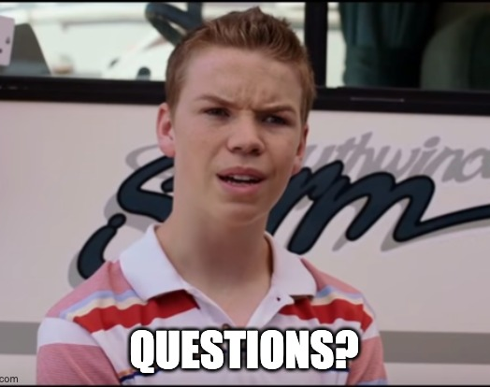
Thank You!
DJ Ralston, M.A.
DJ.Ralston@pobox.site

Slide 25
References
Adams, M. E., Bell, L. A. E., & Griffin, P. E. (2007). Teaching for diversity and social justice. Routledge/Taylor & Francis Group.
Koch, T. (2002). Disability and Difference: Balancing Social and Physical Constructions. Journal of Medical Ethics, 27, 370–376. https://doi.org/10.1136/jme.27.6.370
Holzman, L. (2018). The Overweight Brain: How our obsession with knowing keeps us from getting smart enough to make a better world. East Side Institute Press.
Duncan, K. (2021). Identifying Nine Types of Unconscious Bias at Work. Blog. JobSage.
Ratts, M. J., Singh, A. A., Nassar‐McMillan, S., Butler, S. K., & McCullough, J. R. (2016). Multicultural and social justice counseling competencies: Guidelines for the counseling profession. Journal of Multicultural Counseling and Development, 44(1), 28-48.
Schein, E. (2013). Humble Inquiry: The gentle art of asking instead of telling. Barret-Koehler Publishers, Inc.

