Slide 1
You Can’t Pour From an Empty Cup!
Ok, but…what does this mean in my real life?
Genevieve Habeck, Director of Education and Outreach

Slide 2
Part One:
Intro, grabbing a pen and paper, and polling the audience
Defining self-care (including actual tips and tricks; none of the usuals!)

Slide 3
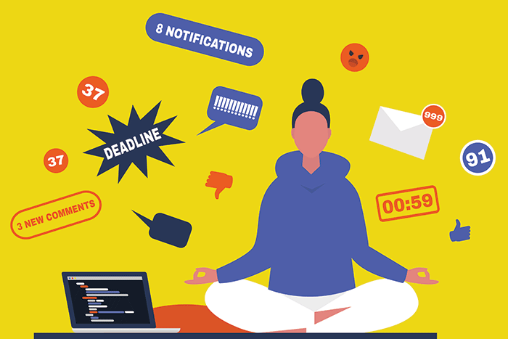
Let’s talk about the barriers
Time
2. Money
3. Guilt (argh!)
4. Mental energy

Slide 4
BE GENTLE, YET REALISTIC
Think about how you’d talk to a client, or your sister, or your best friend.
If they told you how burnt out they are, what would you say?

Slide 5
Defining self-care in a real way: what it is
Any activity that we do deliberately in order to take care of our mental, emotional, and physical health.

Slide 6
Defining self-care in a real way: what it isn’t
It is not something that we force ourselves to do, or something we don’t enjoy doing.
It is not selfish. (Really.)

Slide 7
TOP TWO pieces of advice!
Write it down. Start with daily or weekly. Hey look – we’re starting today!
Be realistic. Let’s all keep our expectations low yet encouraging.

Slide 8
Part Two:
Creating our own mini wellness plan
Sharing and commitment

Slide 9
Don’t feel like you have to start with the basics or building blocks.
(controversial! ☺)
Sleep, water, exercise, sunshine. We know, we know.
Maybe you can’t tackle these right now. Maybe they’re as good as they’re going to get.
It’s okay.

Slide 10
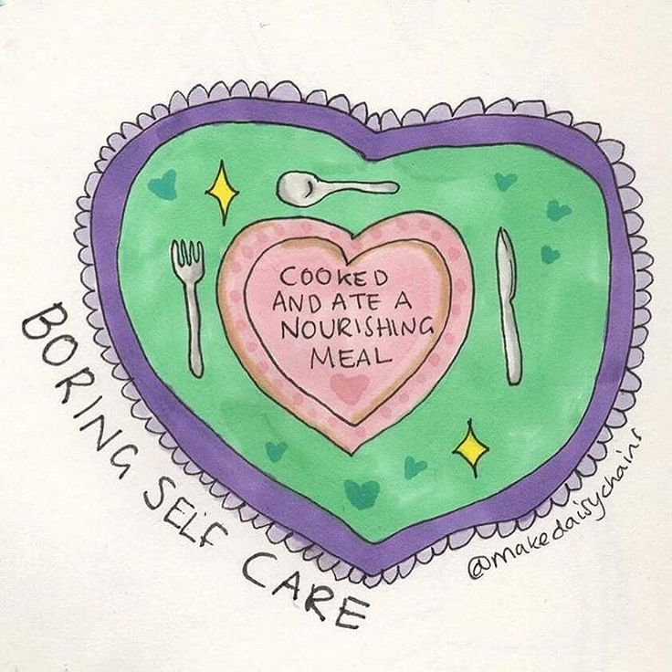
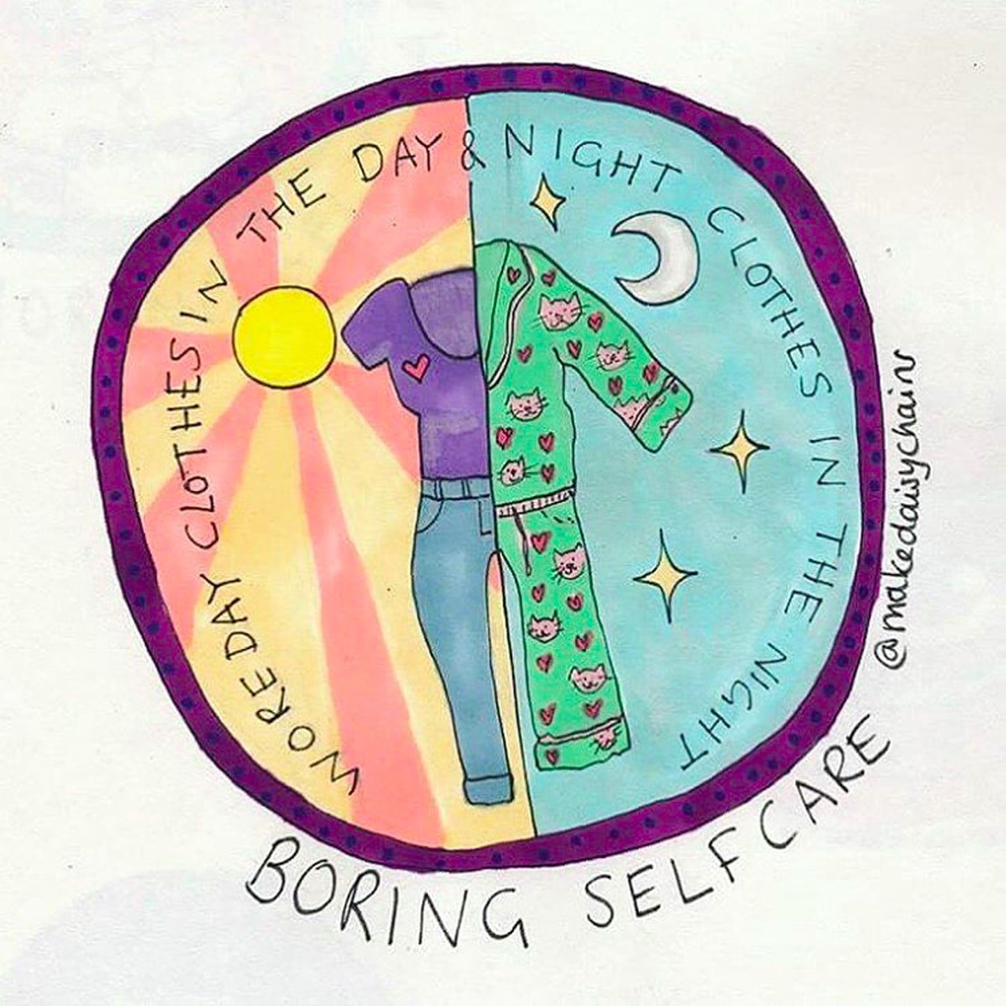
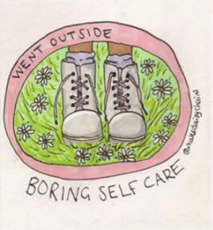
Start small.
Write down the tiniest thing you can do today that will make you feel the tiniest bit better.
Maybe even smaller.
Ok, that’s good.
@makedaisychains

Slide 11
Let’s build on that a little.
Remember: start with something very doable, and it does not have to be a classic self-care move.

Slide 12
Look at the two things you wrote.
Need a few small examples?
Make a gratitude list
Listen to upbeat or relaxing music
Make sure all of your prescriptions are on auto-fill
Stand in the shower with the hot water pouring over your back; hang a Do Not Disturb sign on the door
Spend three minutes taking deep breaths
Turn your phone off for 30 minutes (!!!!! Ok, maybe 20)
Light a yummy smelling candle and just enjoy it
Read a book for 20 minutes
Unfollow someone on social media who is negative or makes you feel badly
Do either of them make your heart sing?
Do either of them drop your shoulders from around your ears?
Ok, that’s the one!

Slide 13
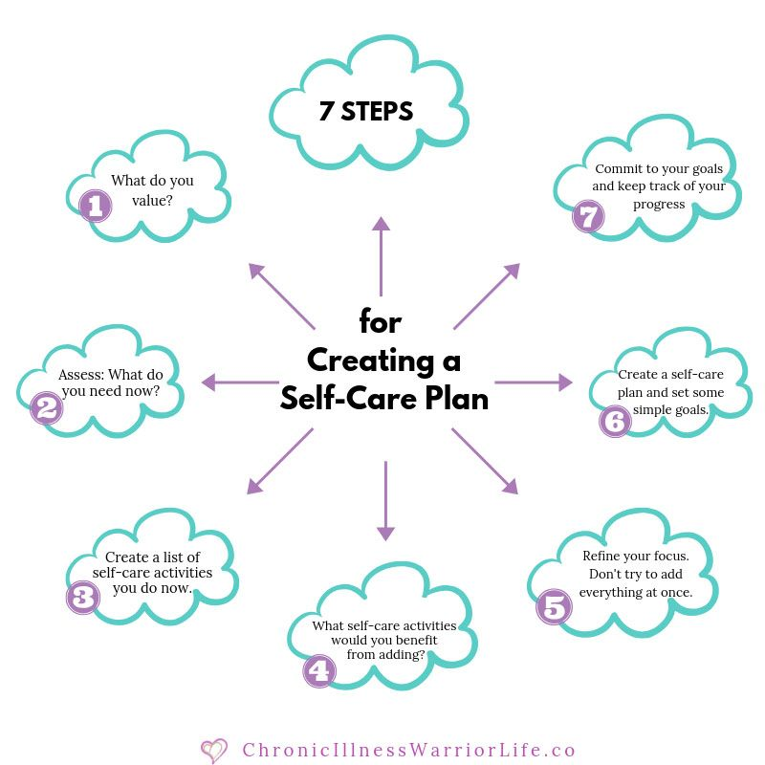
So, you have your one thing written down.
Circle it.
Write this down too: How often over the next week can you do this? Now you’ve got the first week of your new self-care plan! #newweeknewme

Slide 14
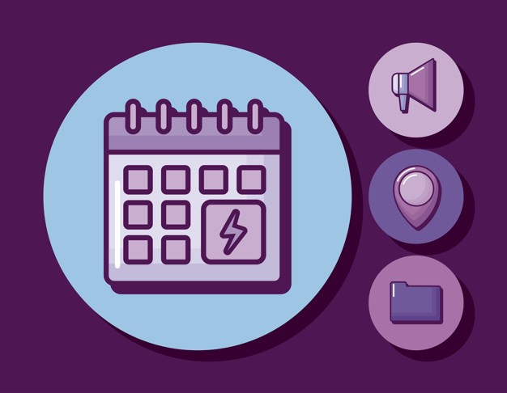
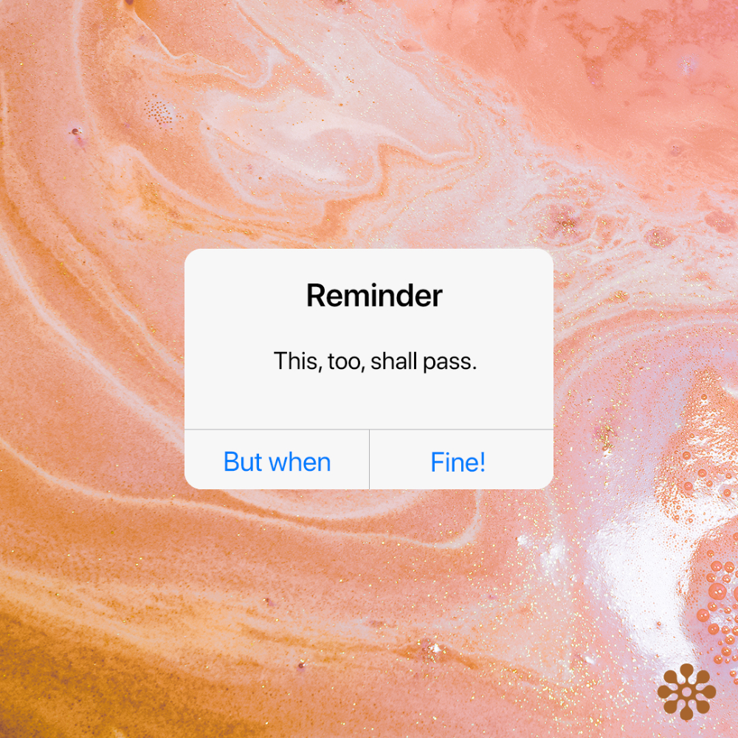
How can you keep these small changes going?
- Make a reminder in your calendar (right now if you can): add a new small goal!
- Care buddy or online support group: Keep each other gently accountable.

Slide 15
OF COURSE……
Call EAP! We’re fully remote and offer consultations, HIPAA-compliant telecounseling, resources, and more.
866-660-9533
www.investeap.org (pw: vteap)

