Slide 1
Transition Assessment Planning for Students with Significant Disabilities
Interagency Core Team Event 2021

Slide 2
Who we are
Ben Beatty-Owens, Transitional and Employment Services Specialist, Special Educator, Essex High School
Bill Sugarman, Regional Manager – Barre & Morrisville, Department of VocRehab
Bonnie Haug, Vocational Rehabilitation Transition Counselor, serving in school youth and young adults, Assessment Specialist
John Spinney, Postsecondary Transition and Disability Equity, Student Support Services Division, Agency of Education
Mickey Bonges, Employment Specialist, Essex High School
Taya Tarr, VR Counselor, Division for the Blind and Visually Impaired
Tracy Roux, Assistive Technology Access Specialist, Department of VocRehab

Slide 3
Brief Overview of the Workshop
•Introduction of the Transition Assessment Planning for Students with Significant Disabilities
•Experiences from Employment Specialist from Essex High School
•Sequence of events when working with youth with VR Transition Counselors and Youth Employment Specialist
•Assistive technology services
•Resources for assessments

Slide 4
Transition Assessment Planning for Students with Significant Disabilities
“…is an ongoing process of collecting data on the individual’s needs, preferences, and interests as they relate to the demands of current and future working, educational, living, and personal and social environments. Assessment data serve as the common thread in the transition process and form the basis for defining goals and services to be included in the Individualized Education Program (IEP)”
(The Division on Career Development and Transition of the Council for Exceptional Children)

Slide 5
Key Questions
1) Where is the student presently?
2) Where is the student going?
3) How does the student get there?
Transition Assessment Planning Form
This tool is very helpful for IEP teams planning for what assessments will be necessary.

Slide 6
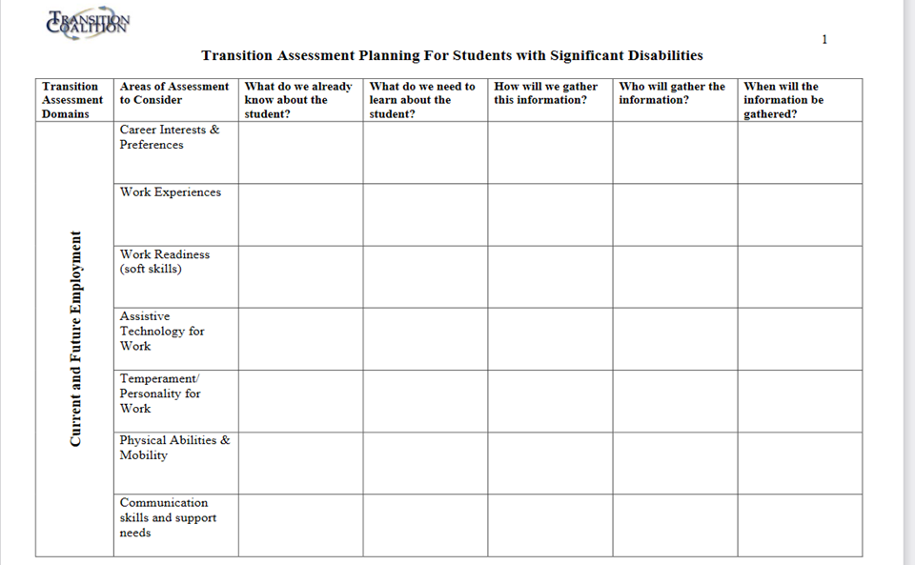

Slide 7
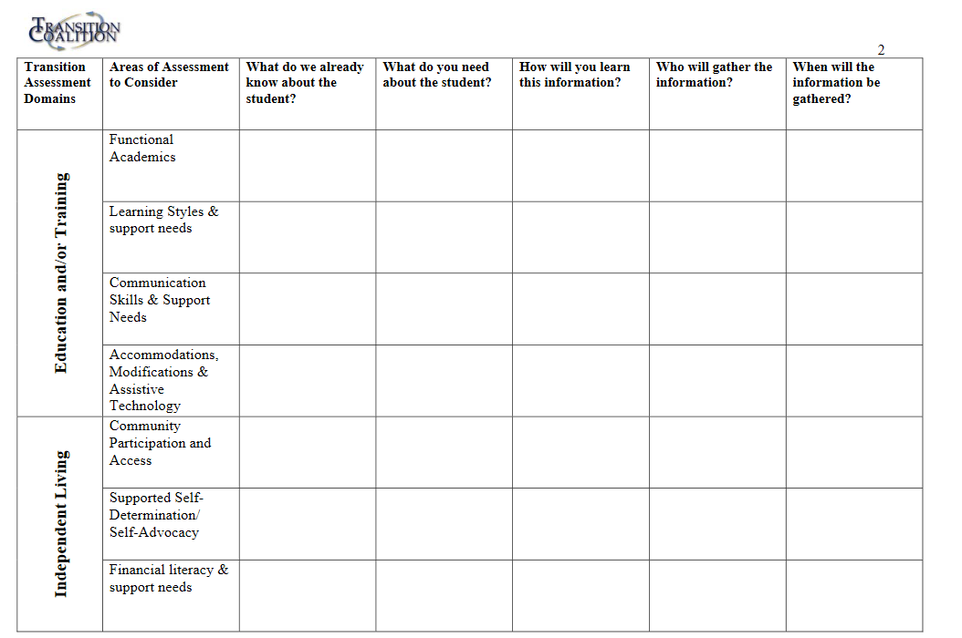

Slide 8
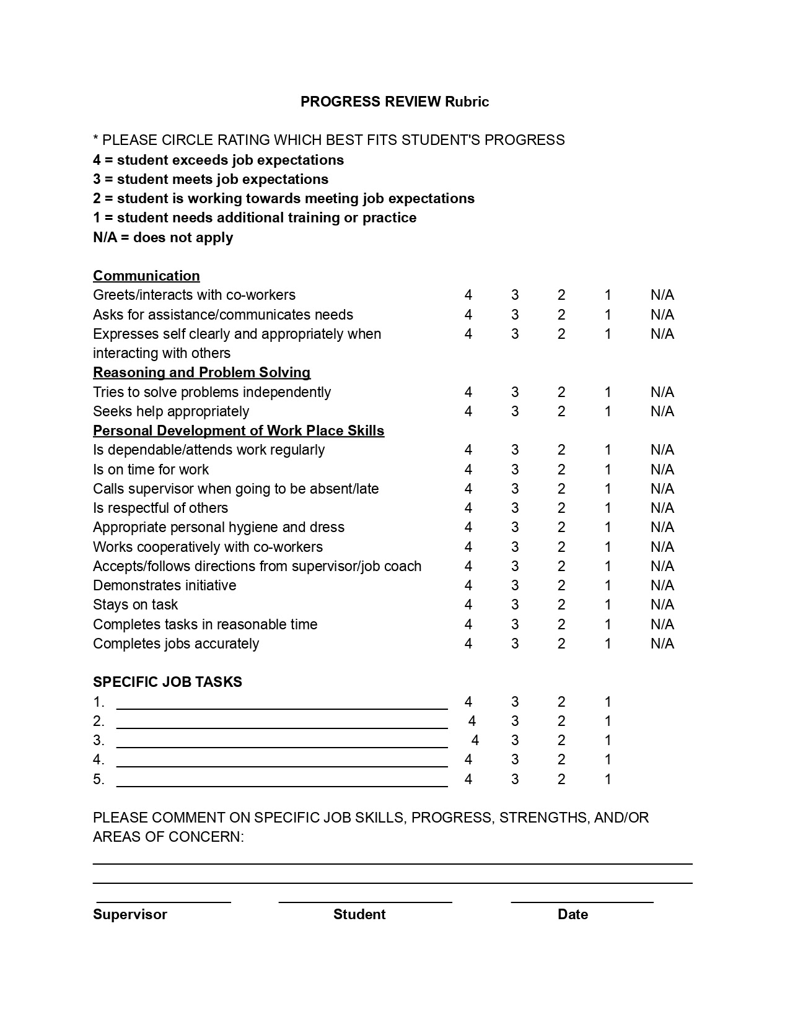
Experiences of an Employment Specialists at school
Post Secondary Assessment for students on IEP’s
Tips - Simple and consistent assessment for all programming works best
Build systems that are accessible and that you can individualize
Make sure Assessment happens before planning
After written assessment, follow up with in person shadows, work trials and, or formalized work experiences
“Soft” skills for employers are more important than “hard” skills. Employer know how to and like training ‘Hard” skills

Slide 9
Dear Students & Families
Please join us for the
Annual
EHS Adult Services Informational via Zoom
Thursday, October 8th, 2020
5:00 p.m. – 7:00 p.m.
Learn more about transition from many of the following:
VocRehab VT, Project Hire, HowardCenter, Transition II, Inc.
Champlain Community Services, Northwestern Counseling & Support Services,
Vermont Center for Independent Living, Avenue 7,
Green Mountain Self Advocates
SUCCEED, Think College Vermont, Project Search, College Steps,
Vermont Family Network, Office of Public Guardian

Slide 10
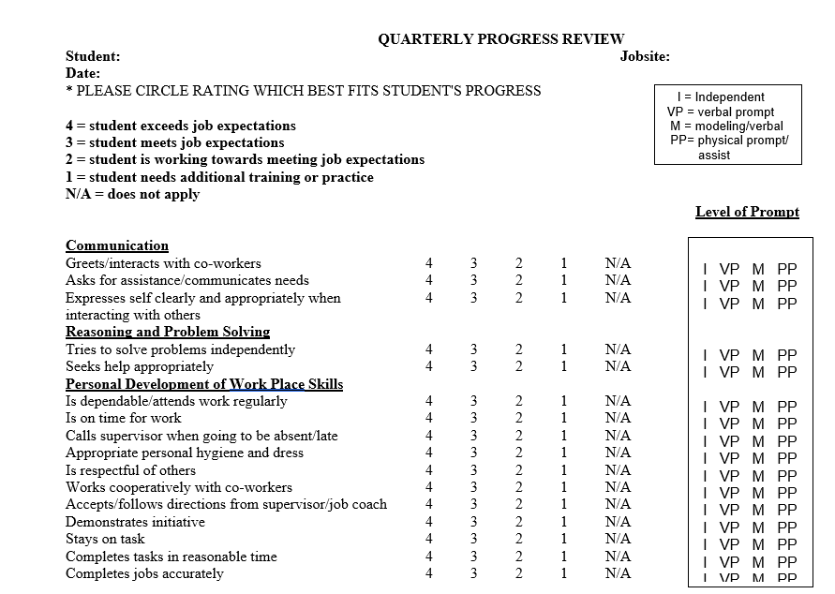

Slide 11
Sequence of events when working with youth
ONLINE (NO ACCOUNT LOG IN REQUIRED):
·CAREER ONE STOP * (interests, skills, work values) https://www.careerinfonet.org Self-reported skills assessment. Has a resume builder. Occupational videos. No log in or account required.
•CareerOneStop: Skills Match
•https://www.careerinfonet.org/skills
•CareerOneStop MySkillsMyFuture
•https://www.myskillsmyfuture.org
•CareerOneStop: Interest Assessment:
•https://www.careeronestop.org/Toolkit/Careers/interest-assessment.aspx (essentially the same as the O*Net Interest Profiler)
•CareerOneStop: Work Values Matcher
•https://www.careerinfonet.org/workvalues
·CAREER INDEX PLUS * (interests, abilities, skills, values) https://www.thecareerindex.com/dsp Self-reporting style that matches to careers based on physical capacity, work conditions, and traits.
·MY NEXT MOVE ONET * (interest profiler, suitable for youth) https://www.mynextmove.org/ https://www.mynextmove.org/explore/ip

Slide 12
VocRehab Assessments that require login
ON PAPER:
•TRANSFERRABLE SKILLS SCALE * (self-rated skills)
·CDM CAREER DECISION-MAKING SYSTEM LEVEL 1 * (interests; easy, low level readers, not for nonreaders, suitable for youth)
·CDM CAREER DECISION MAKING SYSTEM LEVEL 2 * (interests; intermediate readers)
·SDS SELF DIRECTED SEARCH STANDARD * (interests; Holland Codes)
ONLINE:
•WOWI World of Work Inventory * (interests, abilities, personality)
•CAREER SCOPE * (interests, aptitude/abilities, personality)
•VIRTUAL JOB SHADOW * (exploring occupations and related activities, suitable for youth)
•TRANSFERRABLE SKILLS SCALE * Online version. (self-rated skills, based on prior training or experience, may be suitable for youth who have had some work experience)

Slide 13
Importance of Assistive Technology
“For most people technology makes things easier. For people with disabilities, however, technology makes things possible.”
Mary Pat Radabaugh, Director of IBM National Support Center for Persons with Disabilities, 1988
Assistive Technology mentioned in all three Transition Assessment Domains.
AT from school and home will likely still be relevant for work.
Important to incorporate tools early on to increase success later in life.

Slide 14
AT – Who, How, and When
Schools have initial responsibility to supply AT. This is documented in the IEP. Occupational/Physical therapists, Speech and Language Pathologists, Learning Specialist, Special educator, etc. are among the “Who”.
The Vermont Assistive Technology Program can help research ideas. There are 3 AT Try-Out Centers located throughout the state.
Pre-transition age: refer directly to the AT Program. The sooner the better!
Transition age: refer through VR for extra services.
What does considering AT look like?
SETT Framework
Quality Indicators for AT

Slide 15
Resources
Assessment Resources
•Free Transition Assessments
•A-Z Guide Transition Assessments
•NTACT Age Appropriate Transition Assessment Toolkit
Transition Planning Tools:
•Transition Planning Map
•Example Transition Planning Map
•VocRehab- Career Assessment Preferred Tools Checklist

Slide 16
AT Resources
The Vermont Assistive Technology Program
1-800-750-6355
www.atp.vermont.gov
Assistive Technology Inventory: www.vt.at4all.com
Joy Zabala’s SETT Framework for considering Assistive Technology
SETT Documents (joyzabala.com)
Quality Indicators for Assistive Technology Services
Matrix 6: AT in Transition - Quality Indicators for Assistive Technology Services (qiat.org)
Student Self-Evaluation Matrix - Quality Indicators for Assistive Technology - Post Secondary (qiat-ps.org)

Slide 17
Helpful Resources:
Coordination with Guidance around Act 77 (Don’t Duplicate!)
When applicable - Designated Agencies, YPD, Jobcorps
Virtual Job Shadow
The Caeer Game
Dr. Kit Career Videos
Teachers Pay Teachers
Families are the best and most important resource we rely on

