Slide 1
Work Based Learning Experiences in a Virtual World
2020 Vermont Interagency Collaboration Virtual Event
October 27 , 2020
Brenda Simmons and Christine Johnson
The George Washington University
WINTAC

Slide 2
What TA Centers Have Learned From States
Work based learning experiences are most effective when developed in coordination with one or more of the other four required pre-employment transition services.
Meaningful work experiences are typically developed around a career pathway continuum and provide opportunities for students to stack or layer skills.
Successful collaboration promotes business partnership when employers understand how providing a work opportunity for students with disabilities can help meet current workforce needs, a better prepared future workforce, and improved community engagement.
Cross-agency collaboration is most effective when it is out-come driven.
States are still young in evaluating and determining what the data is telling us – much of our data is anecdotal
Notes:
Each of the five required Pre-ETS activities (job exploration counseling, work-based learning experiences, counseling on opportunities for enrollment in comprehensive transition programs or other post-secondary education programs at IHE, workplace readiness training, instruction in self advocacy) help support the student’s successful work experience, and creates an opportunity for the student to build skills upon a career pathway that has multiple on and off ramps toward careers that align with labor market trends, industry recognized credentials, and business needs.
The success of linking students with work, and linking student work experience programs with employer partners, is as much about meeting employers’ needs as it is about meeting the collective goals set by VR and education. Unless employers gain from the collaboration, they are not likely to become or stay involved. Many VR state agencies are successfully using their business specialists to connect with employers and enhance work-based learning experiences.
Collaboration between schools, VR, students, families, employers, provider agencies, and other partners is effective only to the extent it is outcome driven. When collaboration is directly focused on outcomes for students and the systems that serve them – rather than merely referring them for a “hand off” to the next responsible party - higher school completion and employment rates are likely.
The intent of expanding transition services, to include pre-employment transition services in WIOA was to increase opportunities for students with disabilities, including those with significant disabilities to practice and improve workplace skills in competitive integrated work settings before HS exit, and explore post-secondary training options leading to more industry recognized credentials, and meaningful post-secondary employment, which may in turn lead to more meaningful post-secondary employment and training goals in the IEP, and provides increased opportunities for VR to share post-school employment and training outcomes with schools, which may in turn positively affect district level reporting outcomes for all Transition Indicators (1, 2,13, 14)…and vice versa. So this is a win-win for VR and education, and business, but most importantly, for the student.

Slide 3
What is Work-based Learning?
The National Collaborative on Workforce and Disability for Youth defines work-based learning as:
a “supervised program sponsored by an education or training organization that links knowledge gained at the work site with a planned program of study.
Work-based learning is an educational approach or instructional methodology that uses the workplace or real work to provide students with the knowledge and skills that will help them connect school experiences to real-life work activities and future career opportunities.
Work-based learning experiences (WBLE) are one of the strongest predictors of adult employment success for students with disabilities, especially when they are provided early and often, and include opportunities for paid work in competitive, integrated settings.
Notes:
Work-based learning experiences are one of the five required activities for pre-employment transition services (Pre-ETS) outlined in the Rehabilitation Act that must be made available, in collaboration with local education agencies (LEAs), to all students with disabilities who need them, and are eligible or potentially eligible for VR services. In this context, work-based learning experiences, may include in-school or after school opportunities, or experience outside the traditional school setting (including internships), that is provided in an integrated environment in the community to the maximum extent possible. Read slide

Slide 4
Student and Family Engagement
None of this works if the student/family is not engaged, and/or it is too confusing/time intensive
If student is not a minor remember to get their permission to talk with parent/family.
Make it fun and simplify the process as much as possible
Listen to what parent/family feels is important to share, their goals for their child, and then frame virtual WBLE opportunities around those thoughts/concerns.
Respect where they are, some have unrealistic expectations for their child, and some have low expectations and/or no interest in their child working at all, so gain an understanding of their values as a starting point when sharing ideas for virtual work experiences.
Over communicate using email or phone – at a time when everyone is working and delivering services remotely it is easy for messages and things to get lost – send out reminders, etc., ask for parent’s email to cc them on communication with the student.
Maintain a consistent schedule. Do what you say you are going to do. Be professional.
Have virtual meetings with parents - Start meetings on a positive note.
Be mindful not to post recordings and/or videos and pictures of students/families on the internet

Slide 5
Virtual Work-Based Learning Experiences
Career Mentorship: An opportunity for a student to engage with a mentor who teaches or provides career-related guidance and advice.
Informational Interviews: An informal conversation for a student with someone working in a career area/job that interests the student, who will give them information and advice. It is not a job interview and the objective is not to find job openings.
Job Shadowing: An opportunity for a student to observe different jobs and ask businesses questions about the skills, knowledge, and abilities needed to perform the tasks involved in the job.
Workplace Tours/Field Trips: An excursion for students to gain first-hand observation of specific work sites. Students learn about the business, meet employees, ask questions and observe work in progress. Often conducted in a group.
Adapted From: Minnesota's Pre-ETS Toolkit with Resources

Slide 6
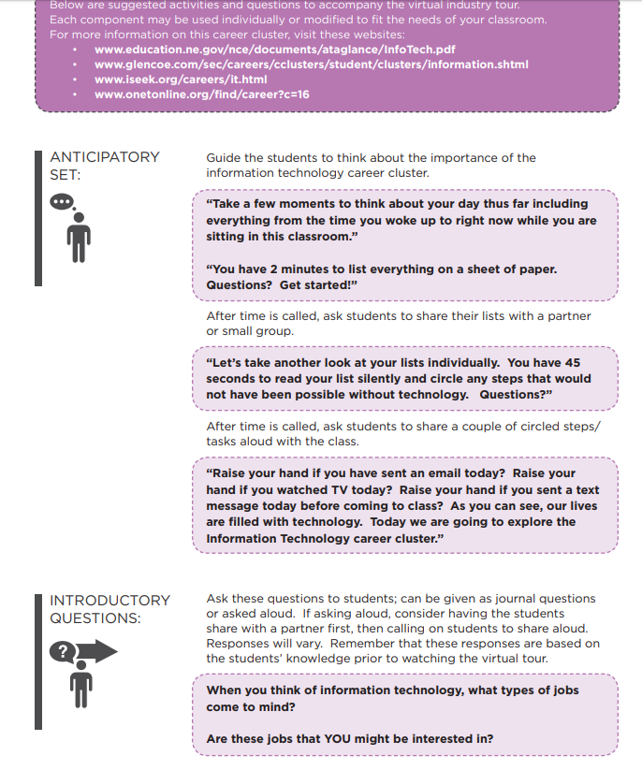
On-Line Career Tours
Online Career Tours

Slide 7
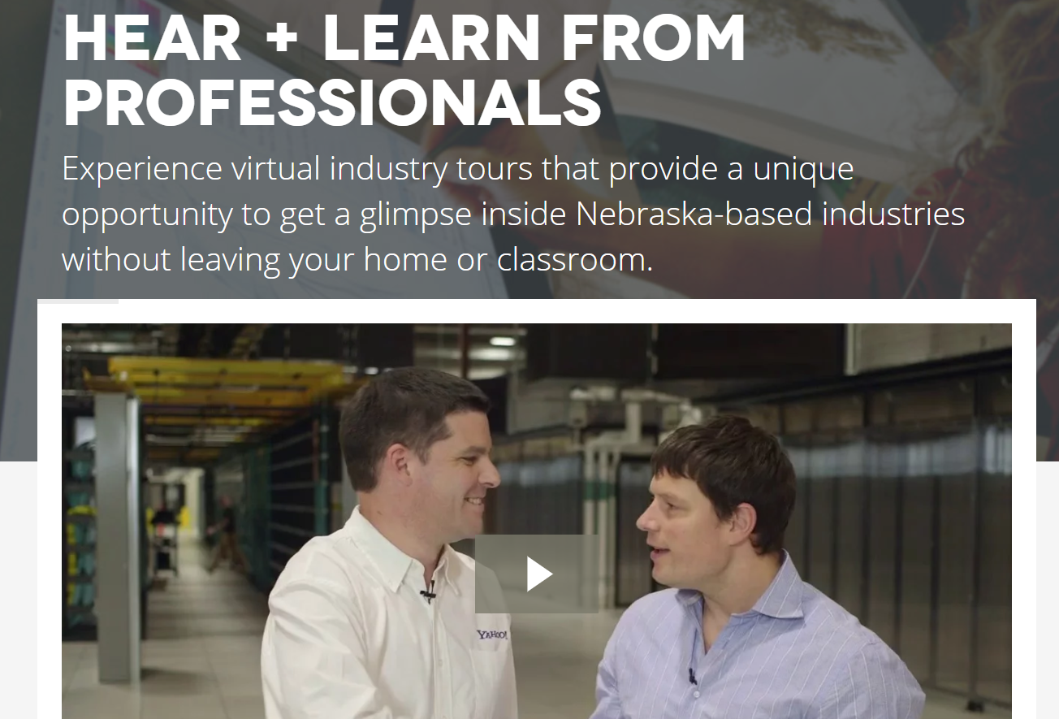
Virtual Industry Tours
Virtual Industry Tours
These virtual industry tours provide a unique opportunity for students, parents and job-seekers to experience Nebraska-based industries without leaving the home or classroom.
The videos showcase different business and industries in each of the sixteen Career Clusters in the Nebraska Model. In addition to the tour of the business/industry, the videos also contain interviews with employees and managers discussing work requirements, education levels, salary and job prospects.
The videos will provide an accurate picture of today’s workplace, breaking down stereotypes and assumptions while emphasizing the knowledge and skills required to be successful.

Slide 8
Virtual Work-Site Tours
Tour Jobs that People Do in One Workplace
Virtual tours and visits are also a great way to show students a range of occupations and career options that may exist within one business or workplace.
For example, an airport, zoo, manufacturing plant
Tour “Essential” Jobs (Today’s World)
Grocery stores, hospitals, garage door repair, Heating and Air, Plumbing companies
Tour businesses that expose students with disabilities to employment opportunities that lead to industry-recognized credentials, and/or opportunities for internships or apprenticeships.
Workplace tours and visits are most engaging when the employer is willing to provide hands-on opportunities for students to experience some aspects of one or more jobs.
Tough to do virtually, but get creative. What might the student have available at home they could touch and work with that was talked about in the workplace video?
If student is really interest in a workplace, document and follow up with an on-site visit in the fall if possible.

Slide 9
Organize Career Cluster Employer Demonstrations
Use Interactive Activities and Choices to Engage Students
Organize an event with employers from all 16 career clusters. One activity as an example, could be modeled after the TV game show, “What’s My Line?”
Professionals in nontraditional careers describe what they do at work and students guess what their occupation is.
Ideas for professionals include a skydiver, a female firefighter, a chef, a falconer, etc.
The professionals each talk about how they got to where they are professionally.
adapted from www.ncwd-youth.info/innovative-strategies

Slide 10
Make Informational Interviews Interactive
To keep students engaged, provide guidance to employers on how to make it interactive.
When employers talk about their jobs on-line, they can bring tools of their trade to show what they do. For example:
a veterinarian can bring x-rays of animals to demonstrate parts of that job.
when inviting employees from a video game design company to speak, ask them to share some video games they are currently developing, and show how they test the games for bugs fix any errors they found.
adapted from www.ncwd-youth.info/innovative-strategies

Slide 11
Mentoring Activities
Career-focused mentoring involves matching students with vetted adult mentors who assist them with career exploration in various ways.
One advantage of career-focused mentoring is its capacity to provide students with more individualized support for exploring careers specific to his or her interests.
The mentoring relationship can consist of telephone or online communication.
What distinguishes career-focused mentoring from general mentoring is that the mentoring interactions are intentionally focused on helping students identify and explore their career interests rather than just providing general support and encouragement.
adapted from www.ncwd-youth.info/innovative-strategies

Slide 12
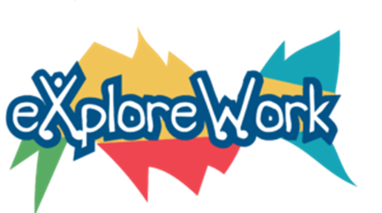
Explore-Work (WINTAC)
Explore-work.com
Series of web-based modules that align with the five required Pre-Employment Transition Services activities that will help students:
Discover talents and jobs that may be a good fit for you!
Get experience and try out jobs right now!
Uncover education and training options to help you meet your job goals.
Learn about self-advocacy or how to ask for and get things you need.
Get skills to help you succeed at work and school.
Available in Spanish
Using Explore-Work.com Webinar
12
Notes:
Developed by WINTAC, Employment Resources, Inc. (ERI), the University of Wisconsin-Madison, and the University of Wisconsin-Stout Vocational Rehabilitation Institute (SVRI)

Slide 13
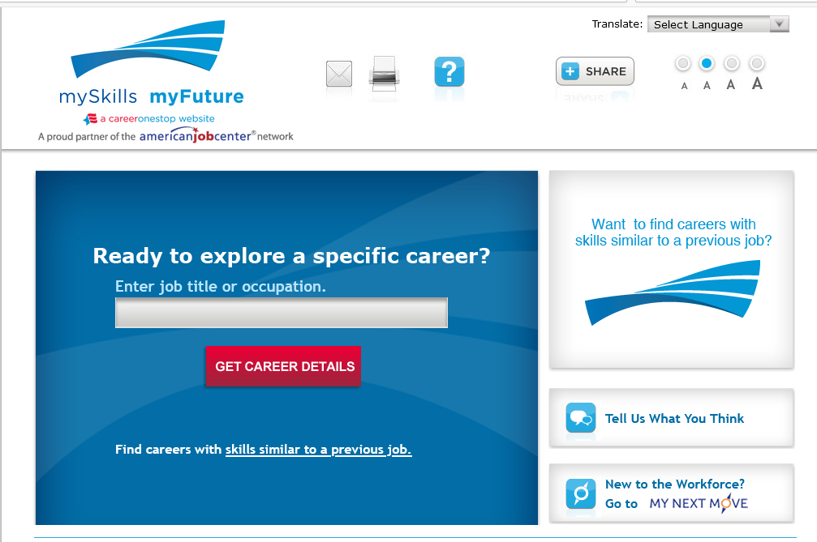
Assess Interests and Explore Careers
CareerOneStop Videos
mySkills - myFuture - Website

Slide 14
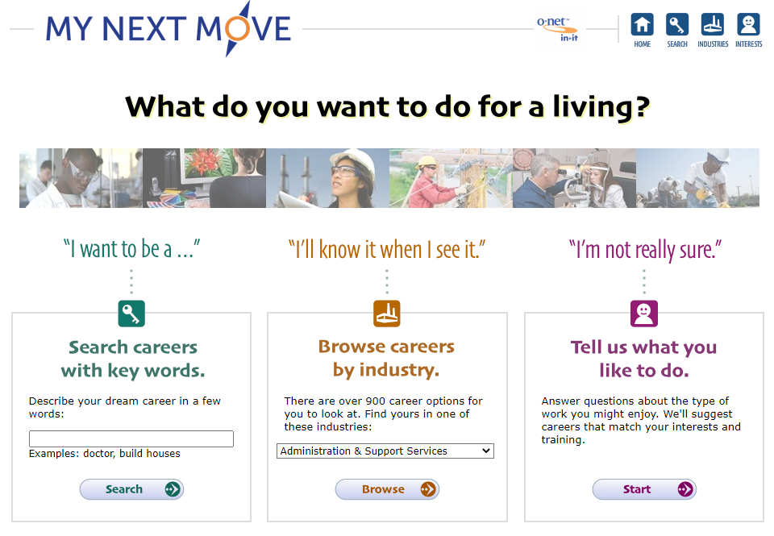
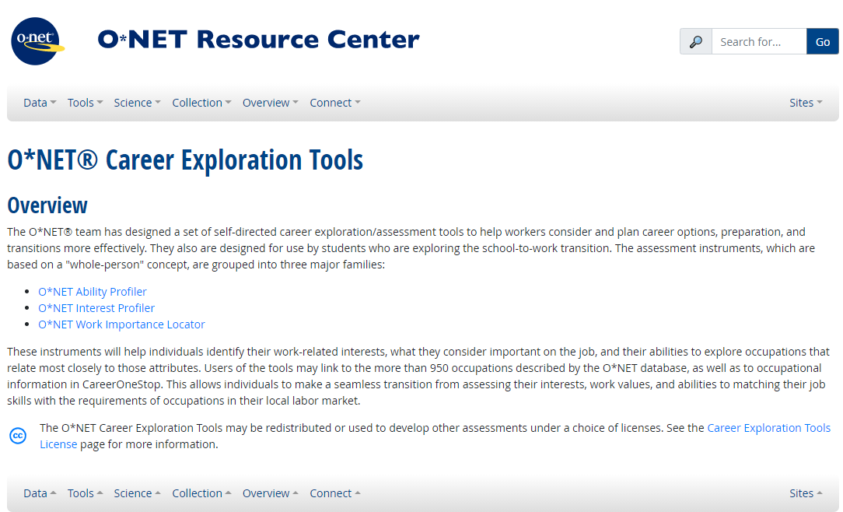
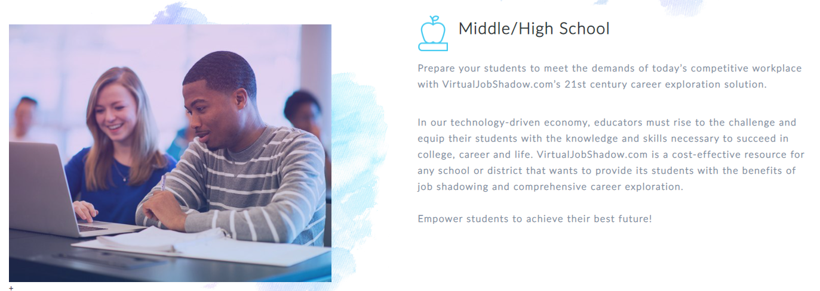
Assess Interests and Explore Careers (continued)
My Next Move
O*Net Career Exploration Tools
https://virtualjobshadow.com/
Notes:
My Next Move is also available in Spanish and it allows students to explore careers in a very fun engaging way, just have the student describe their dream job, or enter the name of the occupation they are interested in, and the student will be taken on an adventure in career exploration. It also includes a career matching feature suggesting careers that match the student’s interests and expected training.
O*Net Career Exploration Tools are a set of self-directed career exploration/assessment tools to help workers consider and plan for careers.

Slide 15
COVID-19 Resources
OSERS
Questions and Answers on Providing Services to Children with Disabilities During the Coronavirus Disease 2019 Outbreak (March 2020)
Supplemental Fact Sheet Addressing the Risk of COVID-19 in Preschool, Elementary and Secondary Schools While Serving Children with Disabilities
OSERS 2020 Transition Guidance Letter
NTACT: https://www.transitionta.org/covid19
WINTAC: http://www.wintac.org/content/covid-19-resources
WINTAC: http://www.wintac.org/content/resources-distance-service-delivery
Transition Coalition blog: https://transitioncoalition.org/blog/webinar/transition-activities-online-athome/
NCSI COVID-19 Resource Hub: https://ncsi.wested.org/
CASE Novel Coronavirus Resources: https://www.casecec.org/
VR Innovative Training Center COVID-19 Resources - https://gwcrcre.org/cit-vr
US Dept. of Education
COVID-19 ("Coronavirus") Information and Resources for Schools and School Personnel https://www.ed.gov/coronavirus
RSA
COVID-19 Frequently-Asked Questions: WIOA Performance Accountability Provisions https://www2.ed.gov/policy/speced/guid/rsa/supporting/rsa-faq-wioa-vr-covid-19-03-26-2020.pdf
Notes:
Transition TN recently recorded a webinar on creative ways to offer work experiences to students amidst the COVID-19 pandemic. Panel presentation of educators through a Q and A format
Many parents are feeling anxious about sending their students to worksites. Any advice on how to address their concerns?
On a district-level, who ultimately decides if community-based instruction and work-based learning can happen?
How do you address wearing masks and other safety precautions with students?
How does liability work if a student either contracts COVID-19 or unknowingly spreads COVID-19 on a job site?

Slide 16
Thank You
WINTAC Pre-Employment Transition Services Team
WINTAC Pre-Employment Transition Services The George Washington University Center for Rehabilitation Counseling Research and Education (CRCRE)
http://www.wintac.org/topic-areas/pre-employment-transition-services
Follow us on
Notes:
Thanks so much, and have a great day everyone!

